Slide 1






ANALYSIS AND DESIGN OF ALGORITHM
COMBINATION USING DECREASE AND CONQUER
Nada Mostafa

Slide 2

COMBINATION
The problem is to generate all possible combinations of length k from a given list n.
Definition
A mathematical algorithm used to calculate the possible number of arrangements of a group of objects where the selection order does not matter

Slide 3


STRATEGY
The strategy used in the provided code is decrease and conquer.
there are 3 types of decrease and conquer which are:
Decrease by One
Decrease by Factor
Decrease by Half
the code i used is using decrease by one

Slide 4

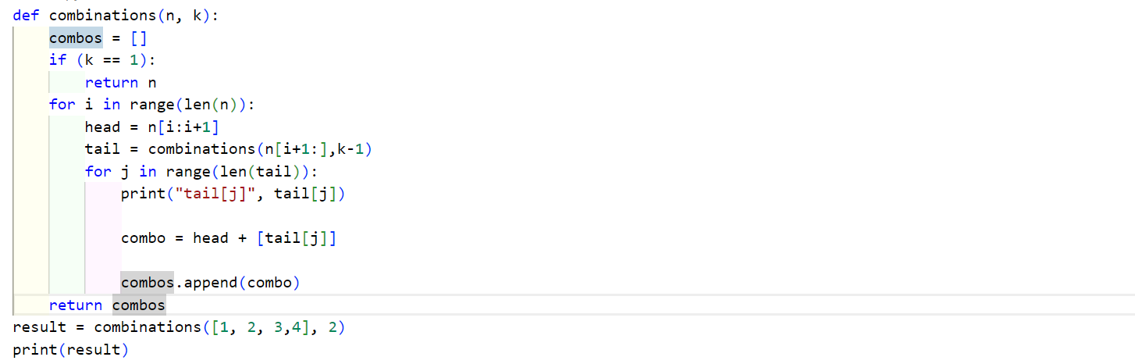


IMPLEMENTATION

Slide 5




VISUALIZATION
01
https://pythontutor.com/render.html#mode=display
https://colab.research.google.com/drive/1afp-lufo5ZG22Np0CSYvdjBF26OQfRtr#scrollTo=B6l82l9izmJE
02

Slide 6

ALGORITHM
01
02
03
04
Base Case
Recursive Step
Combining head and tails
Results
If k is equal to 1, return the individual elements of the list n as combinations.
For each element in the list n:
Select the current element as the "head."
Recursively generate combinations for the remaining elements as the "tail" by calling the combinations function with a reduced k and the next index
for each combination in the "tail," create a new combination by appending the "head" element to it.
Append the new combination to the list of combos.
Return the list of all generated combinations.

Slide 7




ANALYSIS
Certainly, let's break down the steps mathematically:
f(1) = 2 (two choices at the first level)
f(2) = 2 *2(2^2) (four choices at the second level)
f(3) = 2 *2*2 = 2^3 (eight choices at the third level)
f(n)= 2^n (where n is the level of recursion)
Time Complexity:
O(2^n)

Slide 8
Thank you!
Nada Mostafa

